Slide 1
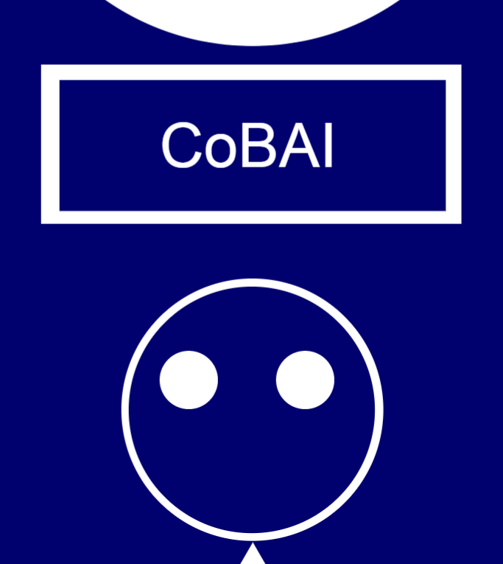
CoBAI (Contoso Bank AI)
Muzamil Khan
muzammilkhan_live@hotmail.com
Notes:
Please enter project details and your details here.

Slide 2
A bit about myself ☺
Some of my hobbies include Cricket, Electronics and new gadgets
Studying Bachelor of Science majoring in CS / IS at UoA
Best part of MSA: PowerPoint presentations, Guidance via GitHub
Future Goals: To own and maintain a potentially popular WebApp.
Popular WebApps that I like – 9GAG, UNILAD and TechCrunch
Notes:
This section is NOT assessed. We just want to get to know you ☺.

Slide 3
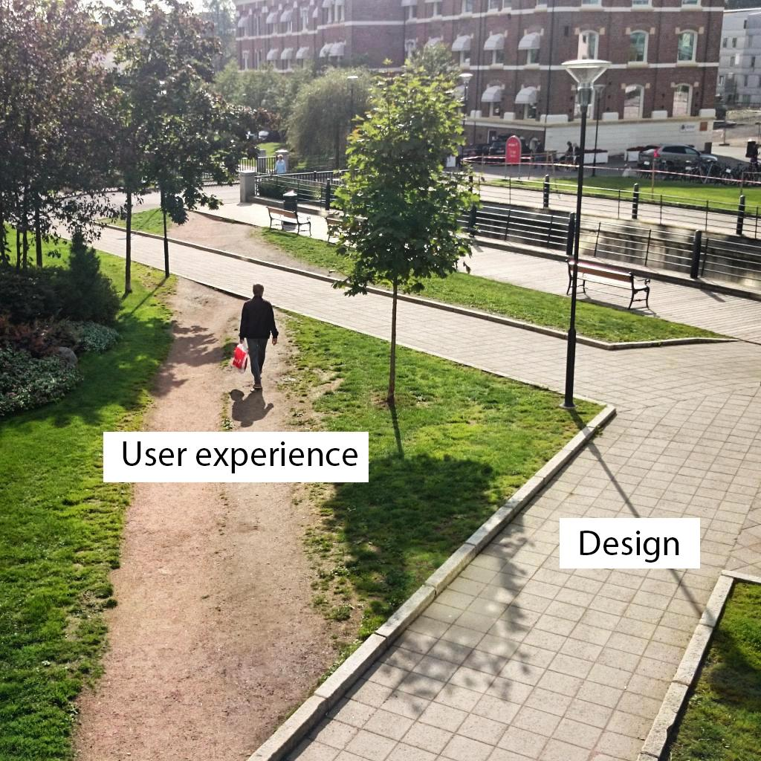
User Experience
With the help of LUIS, I was able to make user experience much better and much friendlier
Design has always been in the cards and design usually depends on the type of channel being used to interact with the bot.
CoBAI sounded like a machine that would potentially pass a Turing Machine Test!
Notes:
User Experience

Slide 4
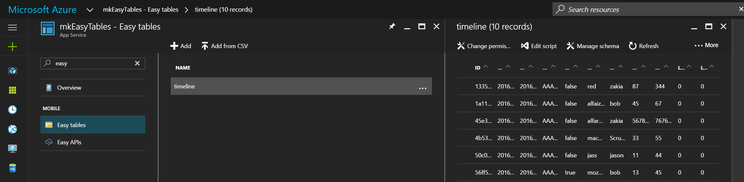
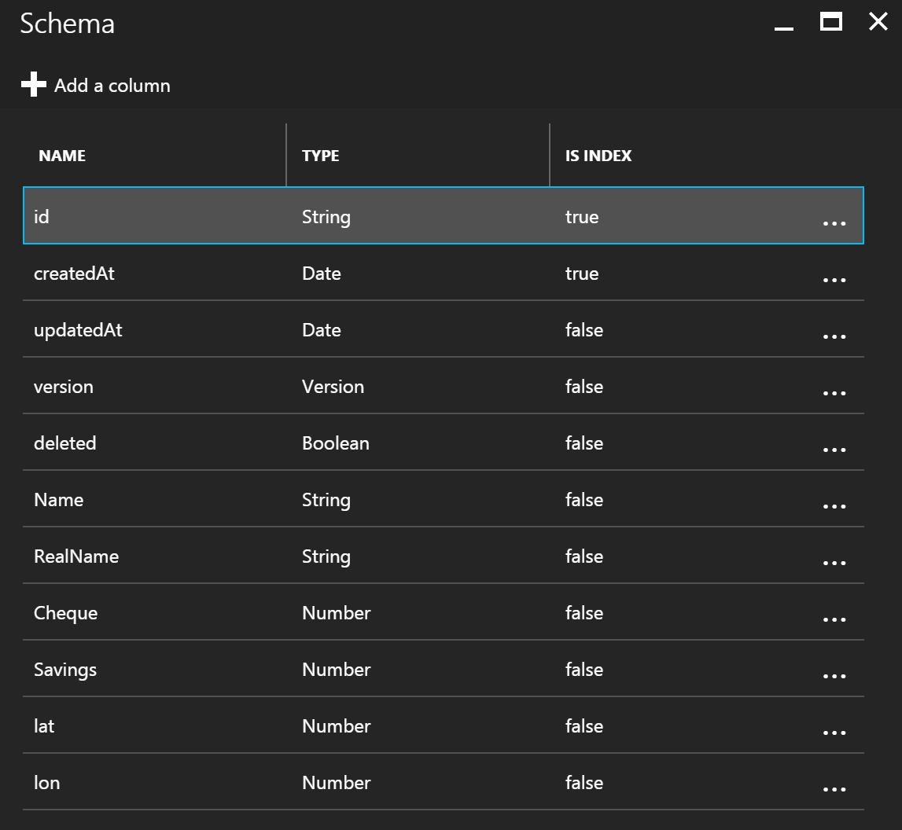
Databases
Created a dummy app within which I implemented a dummy database, using Easy Table
Fields: Name (username), RealName, Cheque, Savings )
{ADD} : An account containing RealName, Name and amount deposited in Cheque and Savings account
{DELETE}: The account (entire row)
{UPDATE}: Name (username)
{READ}: Only the user’s record
Notes:
Talk about your database, what schema you used and what data you used

Slide 5
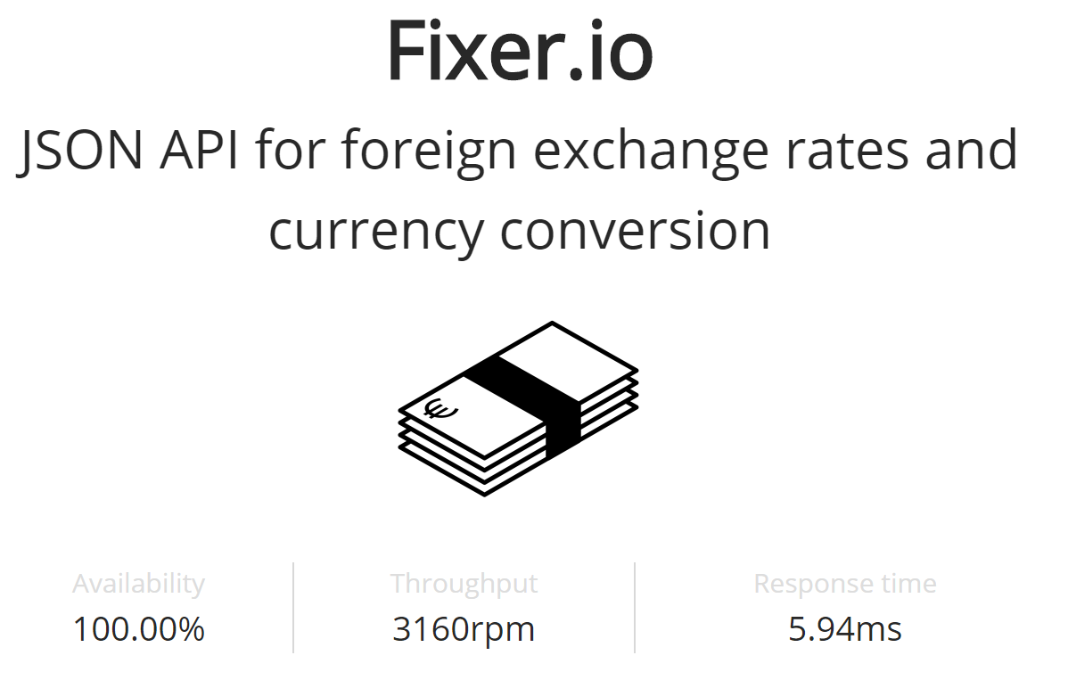
API
Fixer.io is published by the European Central Bank and is updated daily.
Notes:
Advanced features…

Slide 6


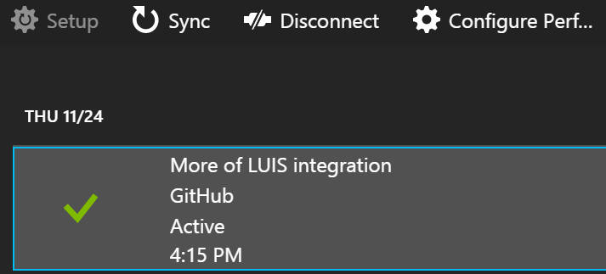
Azure Setup
Cloud Platform
CoBAI App Service is connected to the table through a separate app that is only designed to cater for CoBAI’s back-end database.
GitHub is continuously used via VS for continuous integration and source control
All the services are stored in Azure cloud platform and the code is deployed continuously through GitHub.
Azure
App Service
App Service
CoBAI
Another App
Easy table
Source control
GitHub
table
SQL
Notes:
Explain your Azure features here

Slide 7
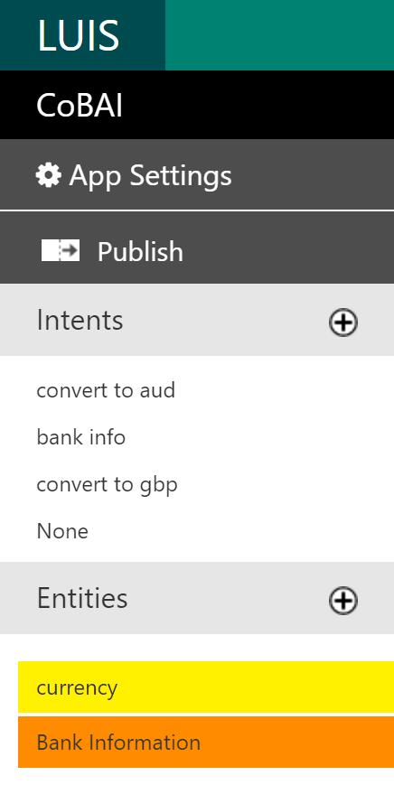
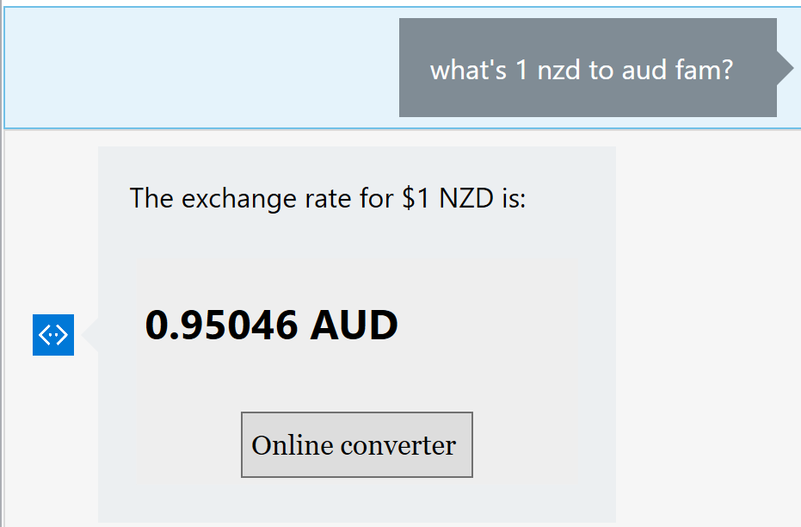
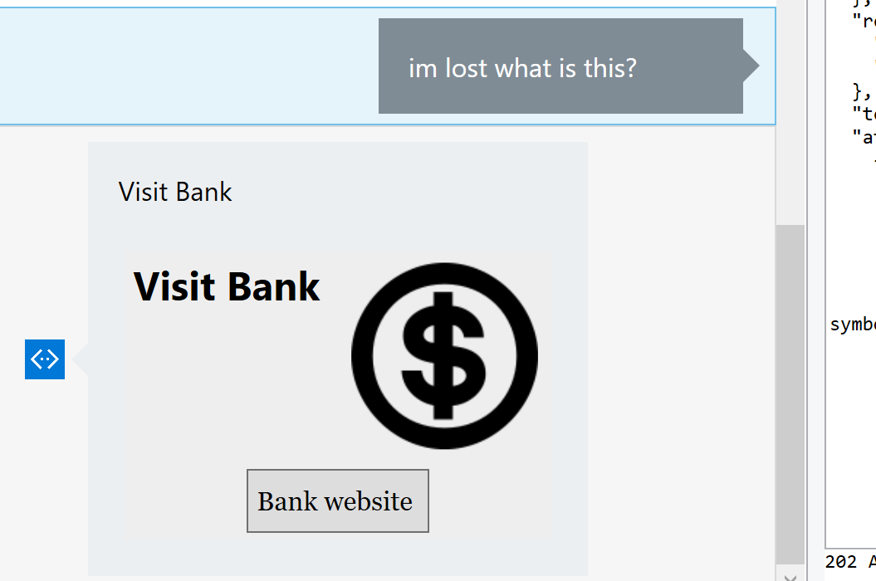
Advanced Features
LUIS makes interacting much more fun..
Notes:
Advanced features…

Slide 8
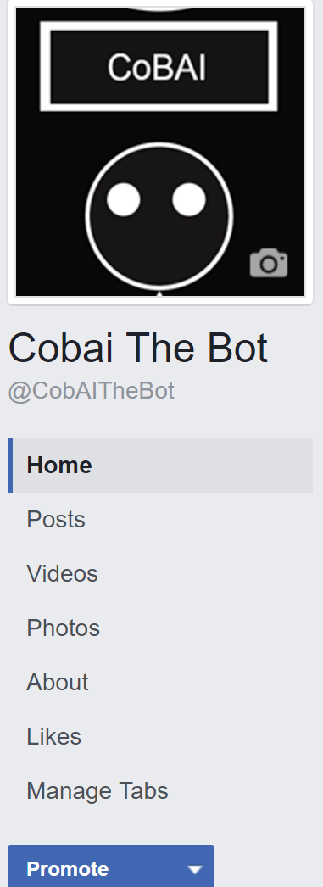
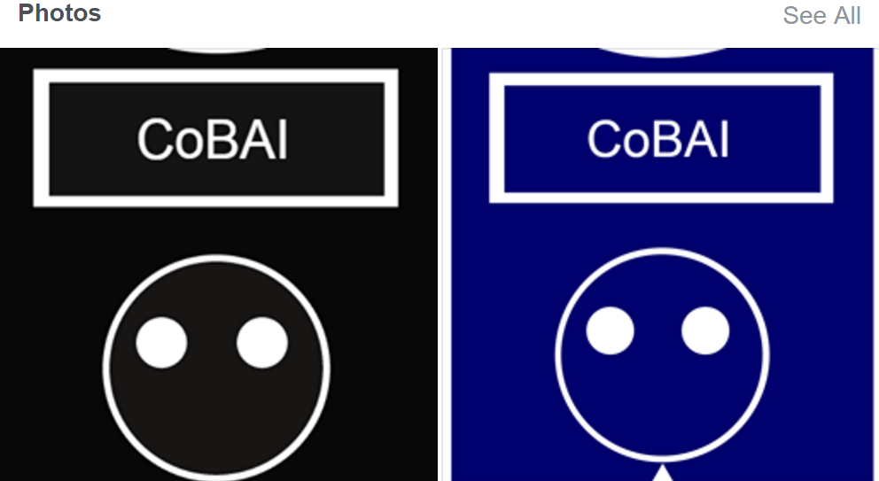
Advanced Considerations
Usage of custom bank branding
Notes:
Advanced considerations…

Slide 9
Final Comments
The Bot is still undergoing heavy implementation, debugging, maintenance (both cosmetic and functional) and testing. ☺ ☺ ☺
GitHub.com/ikhancode
It was fun learning C#
Thank you for your attention
Notes:
Any final things you want to tell us

